Slide 1
Representing the IEDB in OWL
OBI workshop presentation
Vancouver
March 2010

Slide 2

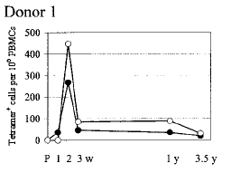
The Immune Epitope Database (IEDB)
Goal: To catalog, organize and make accessible immune epitope information
Epitope discovery contract submission
Literature curation
IEDB www.immuneepitope.org

Slide 3
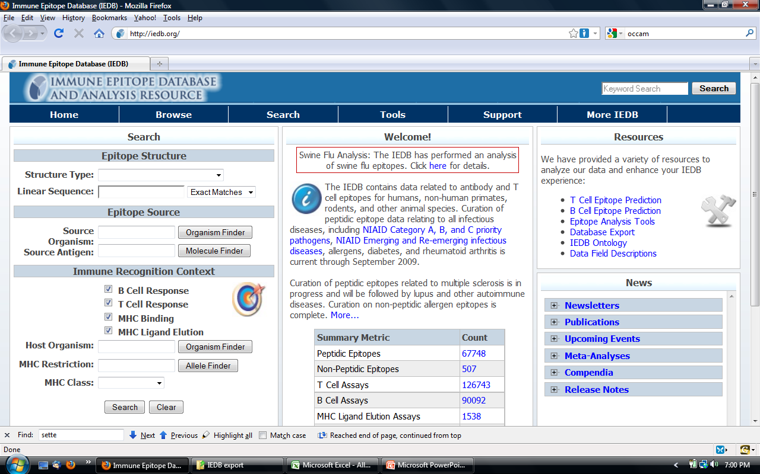

Slide 4
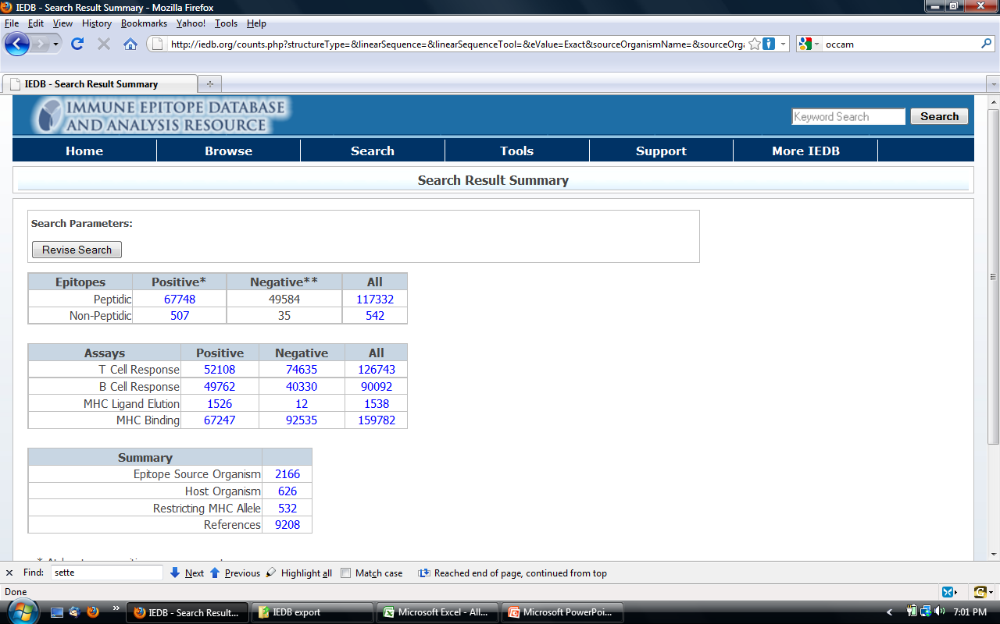

Slide 5
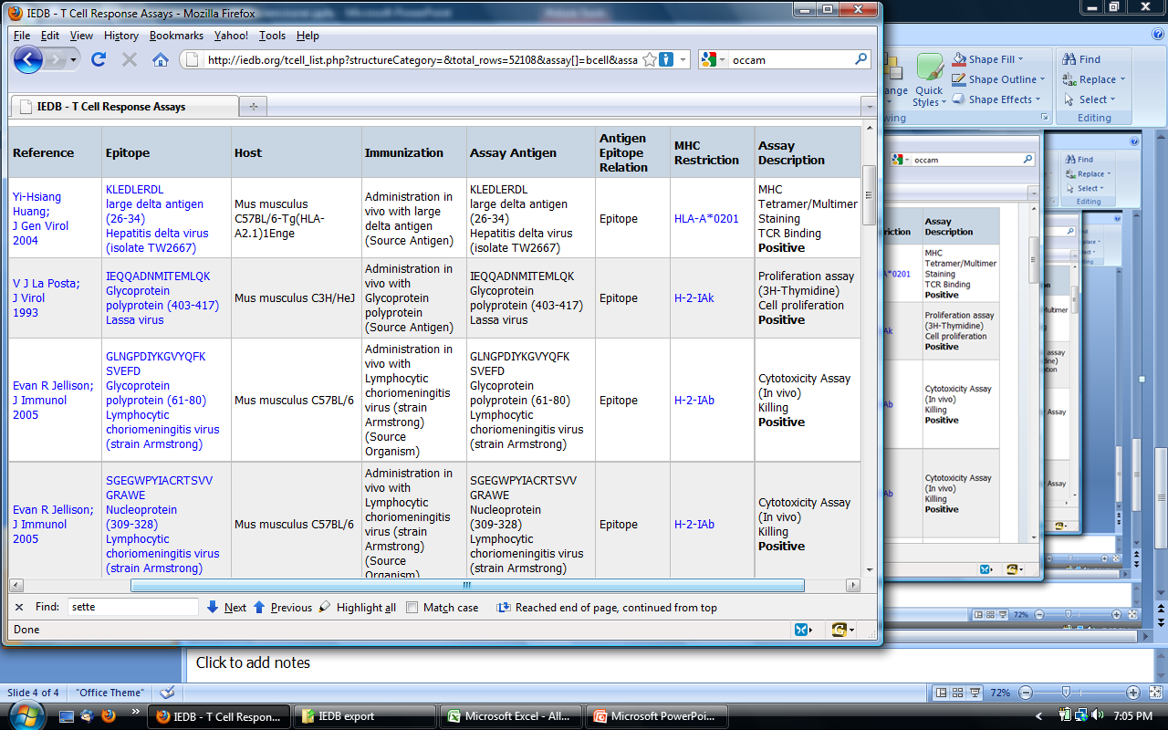

Slide 6
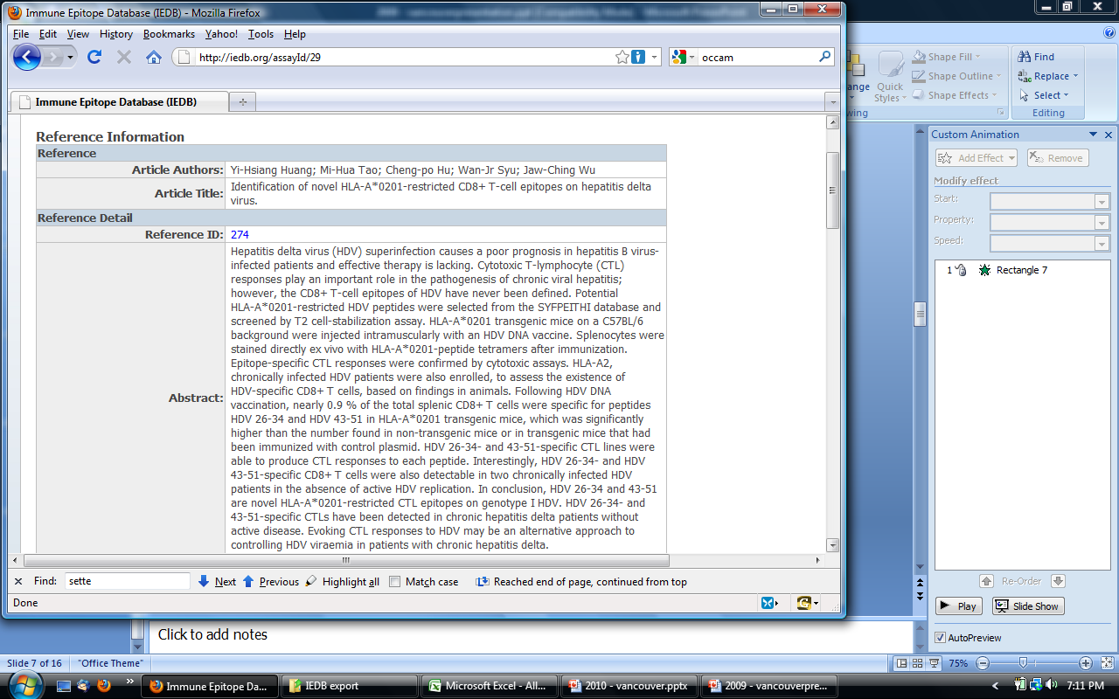

Slide 7
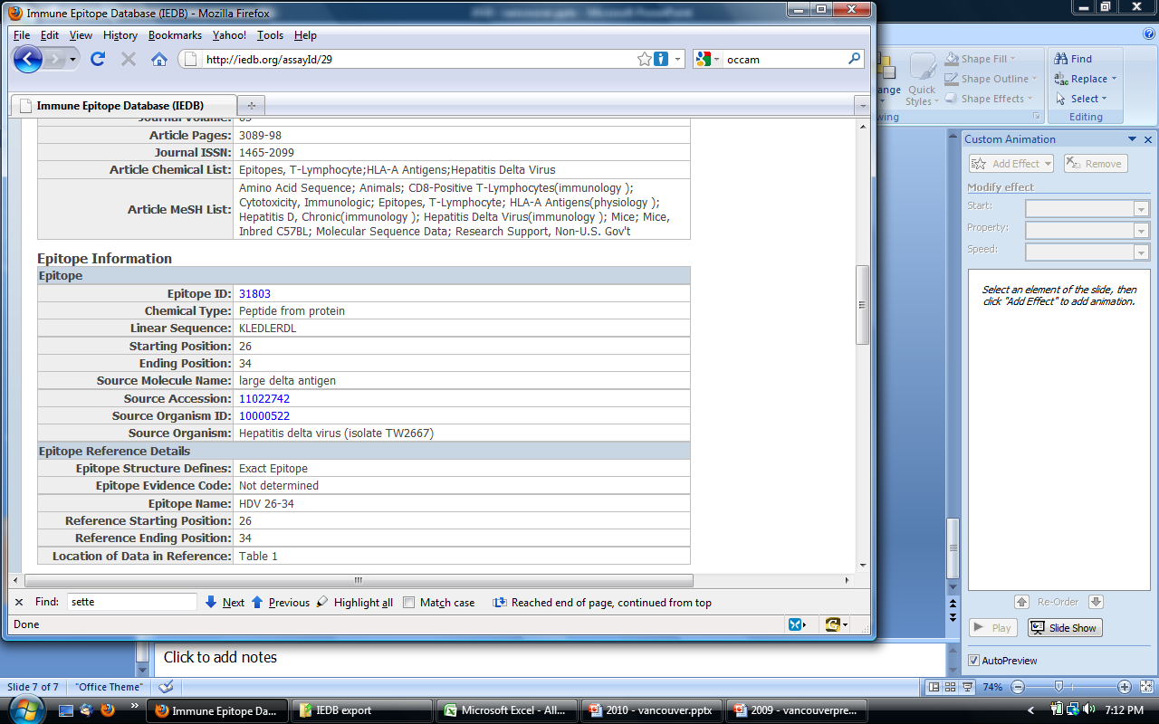

Slide 8
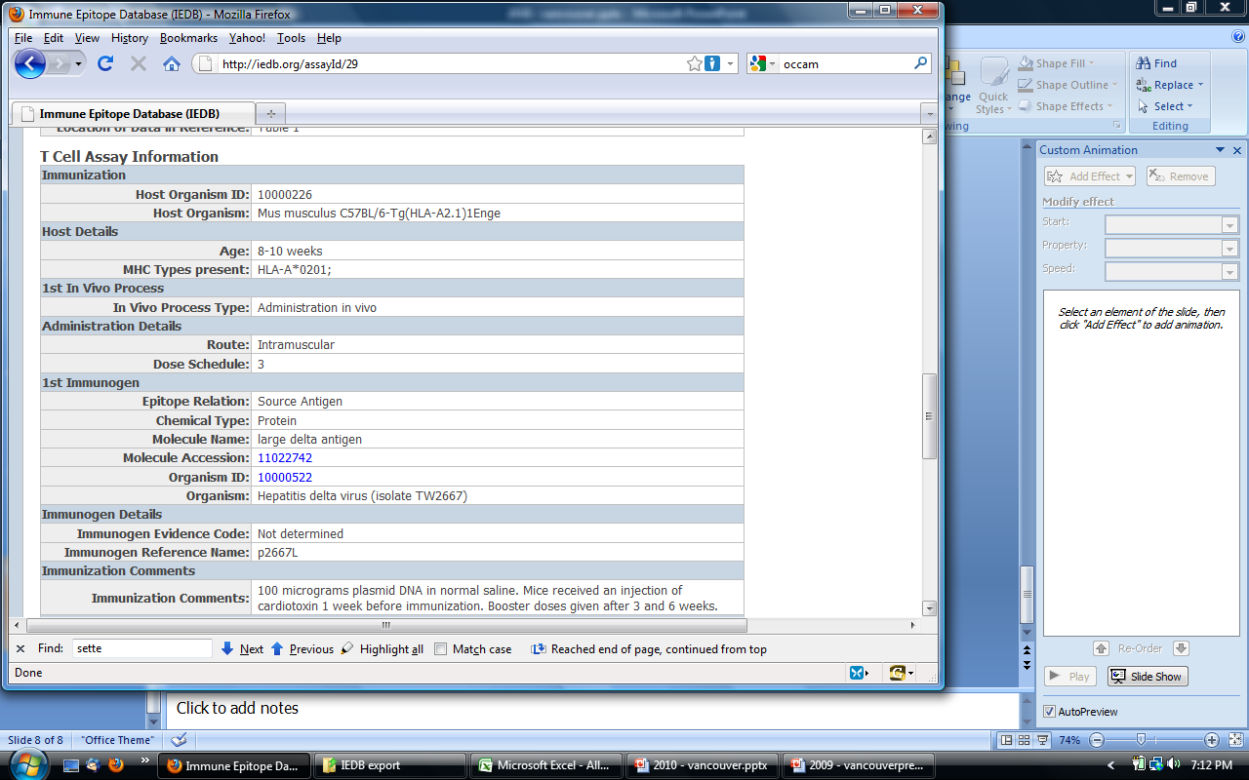

Slide 9
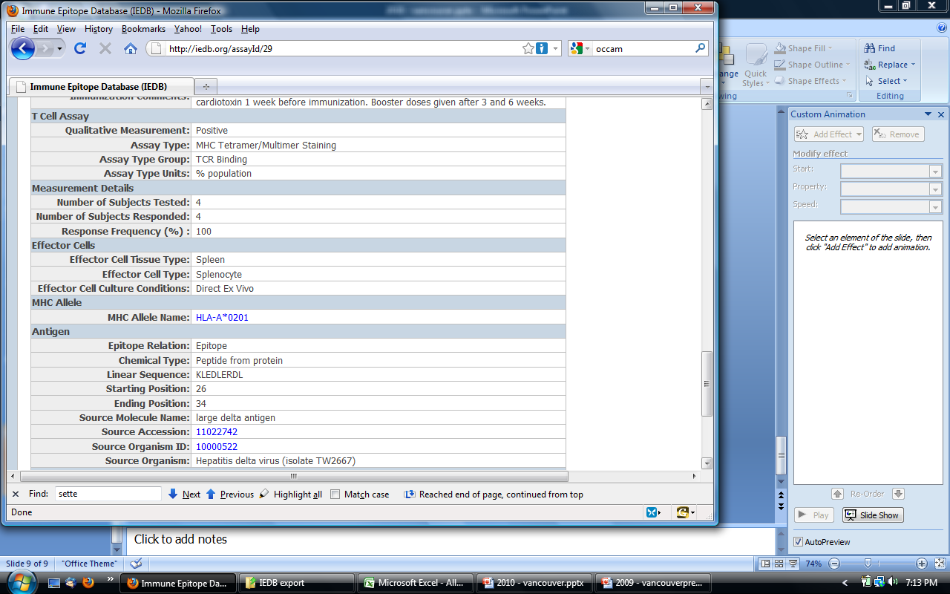
Goal: Represent information in OWL (to allow for reasoning, expressive queries)
by providing export of IEDB into .owl file
This require mapping of DB list values to ontology classes
Current focus: T cell assays

Slide 10
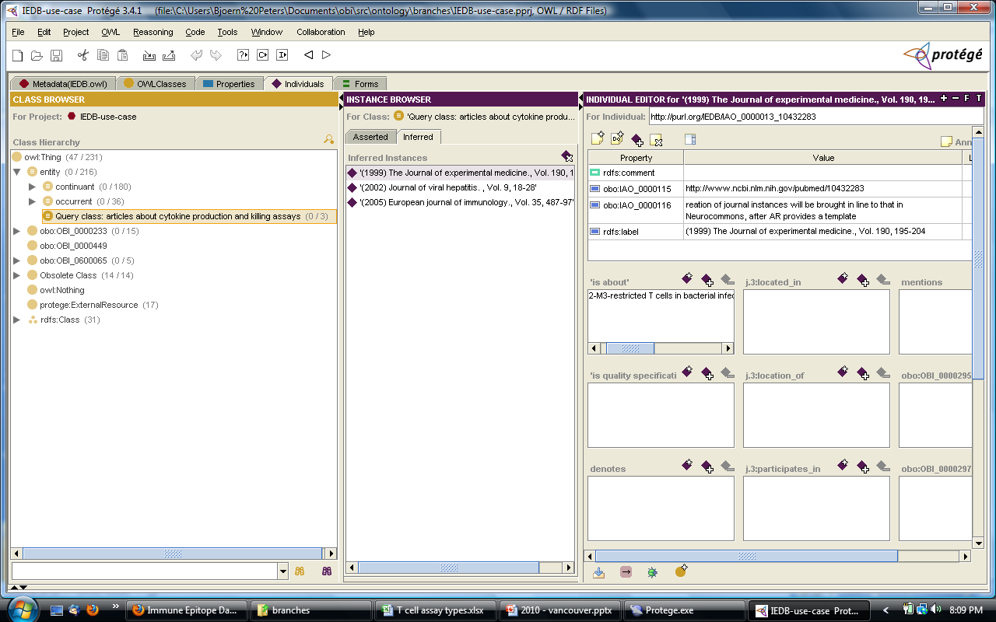
This is all in the paper…

Slide 11
T cell assays
> 125,000 manually curated T cell assays instances
153 entries in the assay table (types)
116 entries after cleanup (merge overlapping entries, remove rarely used entries, remove crap)
31 already in OBI
→ Map (and maintain) all in OBI using QTT

Slide 12
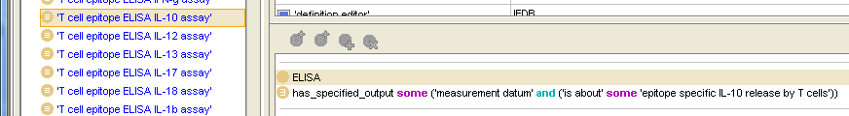
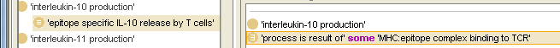
Design pattern
→ Switch to spreadsheet.

